Slide 1
Lecture 10.6 multitasking

Slide 2
Multitasking
Most jobs have more than one dimension – for example, research, teaching and administration.
McAfee gives the example of a convenience store that wants fresh bread delivered twice daily. The tasks required might include:
Planning the route
Driving the truck
Maintaining the truck
A firm might use an independent contractor to undertake the task, or they may use an employee
Q^{n}: What might be some of the implications of each approach?

Slide 3
Multitasking
Independent contractors: have authority where employees don’t such as choice of route; owns truck; usually has some incentive payment; looks after truck and chooses whether to carry other items.
Employees: company may set route; company owns truck; hourly wage; truck maintained by company and company chooses what can and cannot be carried.
Think about why these arrangements are in place and what incentives they create:
To look after truck
Choose an appropriate route
Incentives for side activities
Multitasking focuses on the challenge of designing an incentive compensation scheme when there are a myriad of potentially conflicting goals.

Slide 4
Multitasking
Key issues to consider in multitasking:
Measurement errors: can performance/ activities or output be measured accurately? For example, can you measure if the truck driven carefully? If not, can you define incentives that encourage such behaviour?
Substitution across tasks: incentives for one task will tend to reduce performance on other tasks. Be careful of providing strong incentives on one dimension (such as delivery time for an employee) only.
Risk: if risk is increased, then employees or independent contractors need to be compensated.
These considerations also have important implications for the design of jobs. You want to bundle tasks that have similar characteristics for monitoring activities.

Slide 5
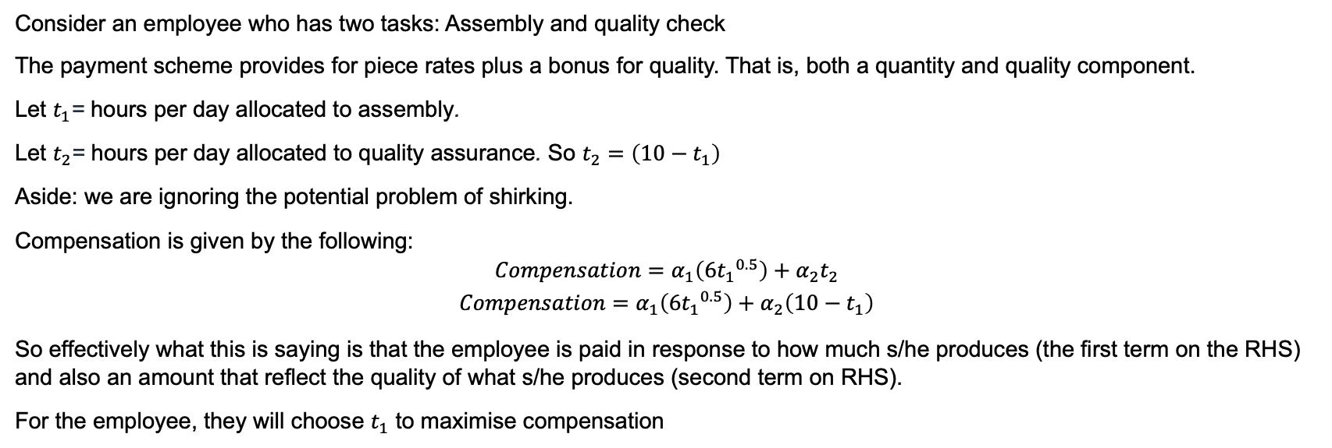
Multitasking
Consider an employee who has two tasks: Assembly and quality check
The payment scheme provides for piece rates plus a bonus for quality. That is, both a quantity and quality component.
Let $t_{1}$= hours per day allocated to assembly.
Let $t_{2}$= hours per day allocated to quality assurance. So $t_{2}=\left({10−t}_{1}\right)$
Aside: we are ignoring the potential problem of shirking.
Compensation is given by the following:
$$Compensation=α_{1}\left(6{t_{1}}^{0.5}\right)+α_{2}t_{2}$$
$$Compensation=α_{1}\left(6{t_{1}}^{0.5}\right)+α_{2}\left(10−t_{1}\right)$$
So effectively what this is saying is that the employee is paid in response to how much s/he produces (the first term on the RHS) and also an amount that reflect the quality of what s/he produces (second term on RHS).
For the employee, they will choose $t_{1}$ to maximise compensation

Slide 6
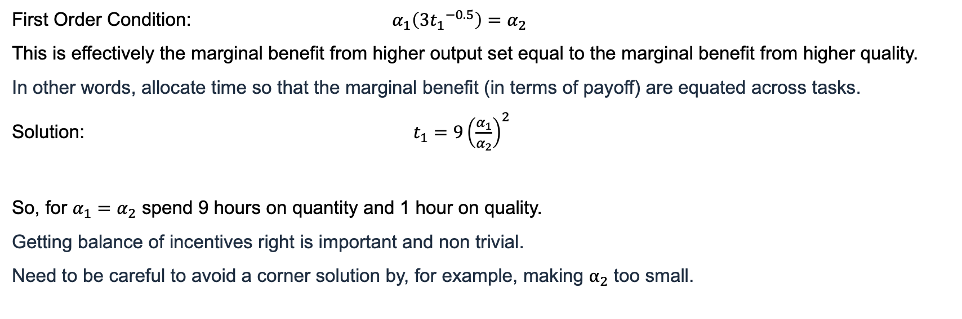
Multitasking
First Order Condition: $α_{1}\left(3{t_{1}}^{−0.5}\right)=α_{2}$
This is effectively the marginal benefit from higher output set equal to the marginal benefit from higher quality.
In other words, allocate time so that the marginal benefit (in terms of payoff) are equated across tasks.
Solution: $t_{1}=9{\left(\frac{α_{1}}{α_{2}}\right)}^{2}$
So, for $α_{1}=α_{2}$ spend 9 hours on quantity and 1 hour on quality.
Getting balance of incentives right is important and non trivial.
Need to be careful to avoid a corner solution by, for example, making $α_{2}$ too small.

Slide 7


($)
MB quantity i.e. $α_{1}\left({{3t}_{1}}_{}^{−0.5}\right)$
α₂
MB quality i.e. $α_{2}$
0
t₁
0
t₁*

Slide 8


($)
MB quantity i.e. $α_{1}\left({{3t}_{1}}_{}^{−0.5}\right)$
Low α₂
MB quality i.e. low $α_{2}$
0
t₁
0
t₁*

